Slide 1
Connectionist Computing
COMP 30230/41390
Gianluca Pollastri
office: CASL, ground floor Science East.
email: gianluca.pollastri@ucd.ie
Connectionist Computing COMP 30230

Slide 2



Credits
Geoffrey Hinton, University of Toronto.
  borrowed some of his slides for “Neural Networks” and “Computation in Neural Networks” courses.
Ronan Reilly, NUI Maynooth.
  slides from his CS4018.
Paolo Frasconi, University of Florence.
  slides from tutorial on Machine Learning for structured domains.
Connectionist Computing COMP 30230

Slide 3
Lecture notes on Moodle
https://csmoodle.ucd.ie/moodle/course/view.php?id=288
Strictly confidential...
Enrolment key: 30230cc
Connectionist Computing COMP 30230

Slide 4
Books
No book covers large fractions of this course.
Parts of chapters 4, 6, (7), 13 of Tom Mitchell’s “Machine Learning”
Parts of chapter V of Mackay’s “Information Theory, Inference, and Learning Algorithms”, available online at:
http://www.inference.phy.cam.ac.uk/mackay/itprnn/book.html
Chapter 20 of Russell and Norvig’s “Artificial Intelligence: A Modern Approach”, also available at:
http://aima.cs.berkeley.edu/newchap20.pdf
More materials later..
Connectionist Computing COMP 30230

Slide 5
Marking
3 landmark papers to read, and submit a 10-line summary on Moodle about: each worth 6.67%
a small connectionist tool to build and play with: 30%
Final exam: 50%
Connectionist Computing COMP 30230

Slide 6
VC dimension
VC(H) is the size of the largest set of points S that can be shattered by H
Examples for 2D data points:
  VC(axis-parallel-rectangles)=4
  VC(circles)=3
  VC(lines)=3
Connectionist Computing COMP 30230

Slide 7
VC dimension
For n-dimensional data points a linear decision surface has VC(H) = n+1
For instance, for a perceptron with n inputs (n-dimensional data points), VC(H)=n+1
Connectionist Computing COMP 30230

Slide 8
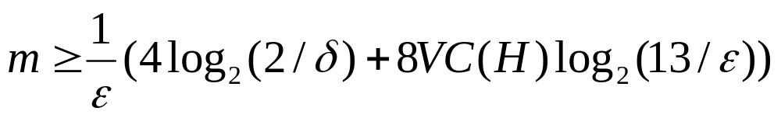
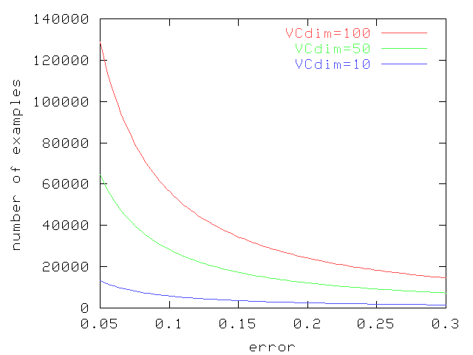
PAC learning and VC dim
δ=0.05
Connectionist Computing COMP 30230

Slide 9
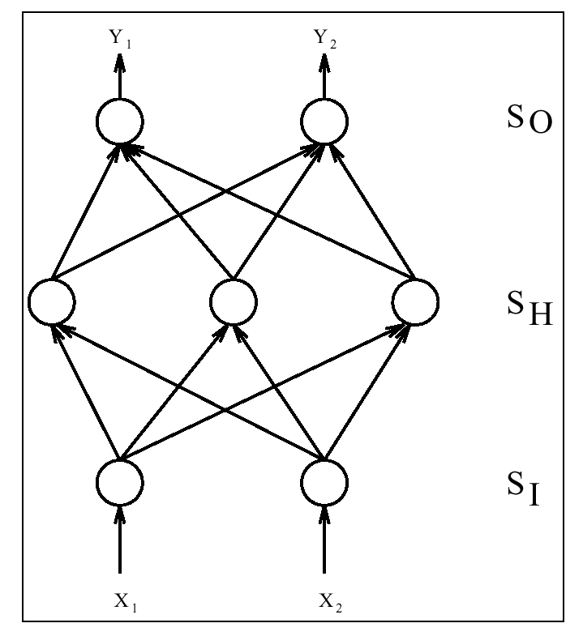
Three layer perceptron
Output layer
Hidden layer
Input layer
Connectionist Computing COMP 30230

Slide 10
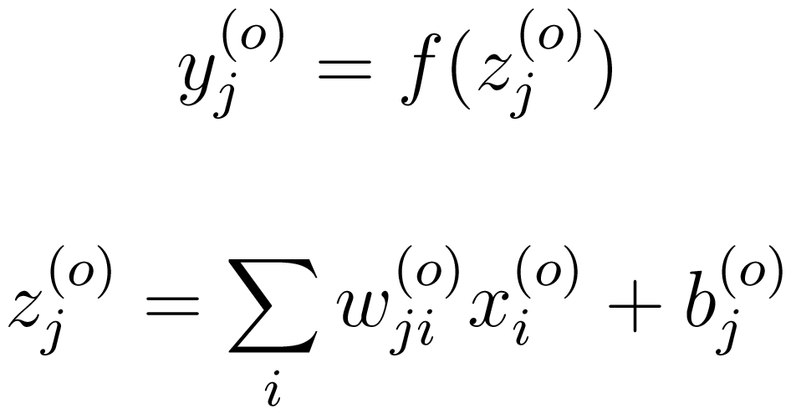
Multi-layer perceptrons
As usual, the outputs y are obtained as a linear combination of the inputs, and then passed through a squashing function (unspecified, for the moment):
y: output
z: activation
x: inputs
Connectionist Computing COMP 30230

Slide 11
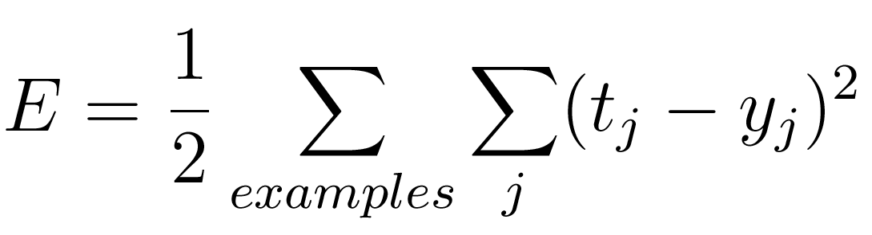
Error, or cost function
We use a squared error to define “fitting the data best”:
Connectionist Computing COMP 30230

Slide 12
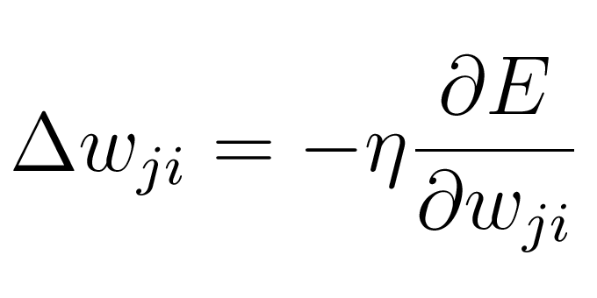
Gradient descent
To figure out how to change the weights so that the error is reduced we can do gradient descent:
This means computing the direction of steepest descent of the error and going there. We saw this already for associators.
Connectionist Computing COMP 30230

Slide 13
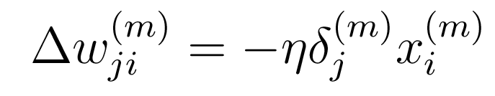
Delta rule
It turns out that this rule applies to networks with any number of layers.
For any layer the gradient of the error (and hence the appropriate weight change) can be computed as:
Connectionist Computing COMP 30230

Slide 14
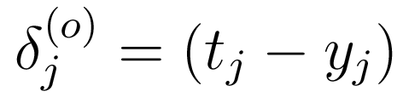
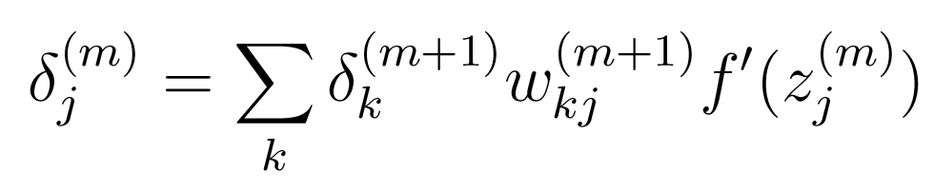
Delta rule
For the output layer, the deltas are:
For any other layer:
Connectionist Computing COMP 30230

Slide 15
Backpropagation algorithm
We just derived backpropagation.
o is the number of layers, x is a global input, t is a desired output, y[] and z[] contain the outputs and the activations of all the layers in the network.
y[0]=x;
for (i=1..o) {
z[i] = w[i].y[i-1];
y[i] = f (z[i]);
}
delta[o]=t-y[o];
for (i=o..1) {
dw[i]= -η delta[i].y[i-1];
delta[i-1] = (delta[i].w[i]) f’(z[i-1]);
}
Connectionist Computing COMP 30230

Slide 16
Backpropagation as message passing
Backpropagation is a schedule for computing weight updates (according to gradient descent) in layered networks of neurons of any depth.
Any layer can be seen as an independent processor passing messages forward and backwards.
Connectionist Computing COMP 30230

Slide 17
Forward, backwards
Forward: digest the input through the weights and produce an output.
Backwards: digest deltas from the layer above, generate new deltas and pass them to the layer below.
During backwards weight updates are also computed.
A layer doesn’t need to know anything about the network topology to do this. Excellent object.
Connectionist Computing COMP 30230

Slide 18
Backpropagation
Works on any Direct Acyclic Graph of continuous units: no binary-threshold (can’t compute f’()).
Loops acceptable only with time delays, we’ll see this later.
Very efficient:
  O(|w|)
  Large networks possible (~10⁴-10⁶ weights reported in many real world applications)
Connectionist Computing COMP 30230

Slide 19
Expressive power
Shortly:
  A single hidden-layer network can approximate every input-output mapping (provided enough units in the hidden layer)
Connectionist Computing COMP 30230

Slide 20
Expressive power
In practice:
If one hidden layer is enough to represent any function, this doesn’t mean it is the most efficient configuration.
It is possible that with multiple hidden layers more complex networks can be represented with fewer weights.
Connectionist Computing COMP 30230

Slide 21
Complexity
Loading problem:
  given a network and a set of examples
  Answer yes/no: is there a set of weights so that the network will be consistent with the examples?
The loading problem is NP-complete
In practice networks can be trained in a reasonable amount of time
Connectionist Computing COMP 30230

Slide 22
Complexity
Gradient descent is a local optimization approach
Often local minima are not a big issue
There are many techniques to try to avoid them, to speed up gradient descent: more about this in the next few lectures.
Connectionist Computing COMP 30230

Slide 23
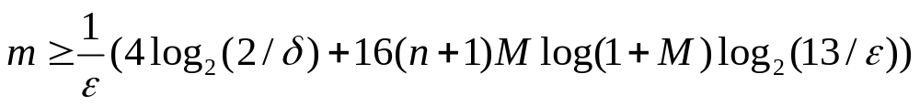
VC dimension of MLPs
Given a DAG of M sigmoidal units and n inputs:
Hence, the sample complexity bound is
Connectionist Computing COMP 30230

Slide 24
VC dimension: Single and Multi-Layer Perceptrons
SLP performs linear separation. If there are n inputs
  VC(SLP) = n+1.
MLP is more powerful:
  VC(MLP) = 2(n+1) M (1+logM)
Connectionist Computing COMP 30230

Slide 25
MLP applications: matching words and sounds
Sejnowski and Rosenberg, “NETtalk, a parallel network that learns to read aloud”, Cognitive Science, 14, 179-211 (1986)
Teaching an MLP how to pronounce English by backprop.
The network was given a stream of words, with the corresponding phonemes.
Once the network had learned, it was possible to make it read.
Connectionist Computing COMP 30230

Slide 26
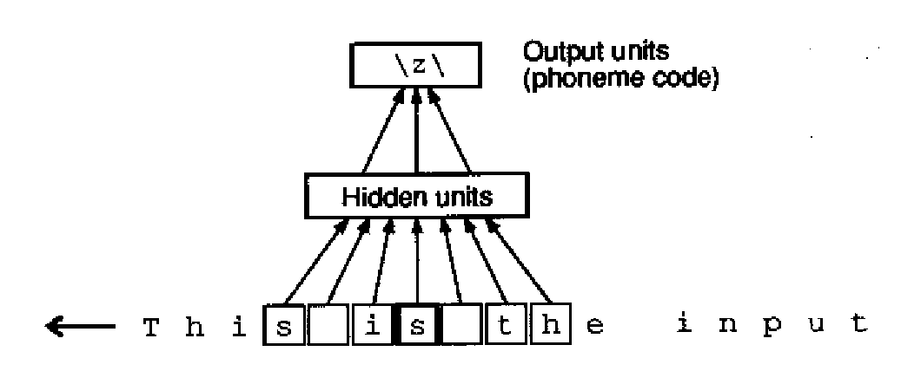
The network
203x80x26 network
input is sliding sequence of 7 characters
80 hidden units
Connectionist Computing COMP 30230

Slide 27
Training
Trained on a corpus of 1024 words with associated phonemes.
Intelligible speech after 10 epochs, 95% correct phonemes on training after 50 epochs.
78% correct classification on test set (“overfits”)
Damaging network produced “graceful degradation”.
Connectionist Computing COMP 30230

Slide 28
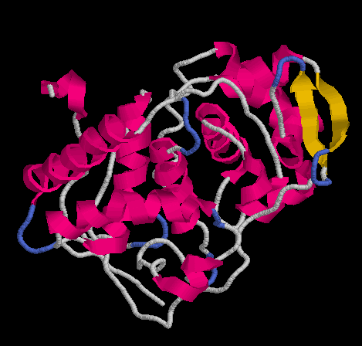
MLP applications: protein secondary structure prediction
Proteins are strings:
FEFHGYARSGVIMNDSGASTKS
GAYITPAGETGGAIGRLGNQAD
TYVEMNLEHKQTLDNG
Structures too:
Connectionist Computing COMP 30230

Slide 29
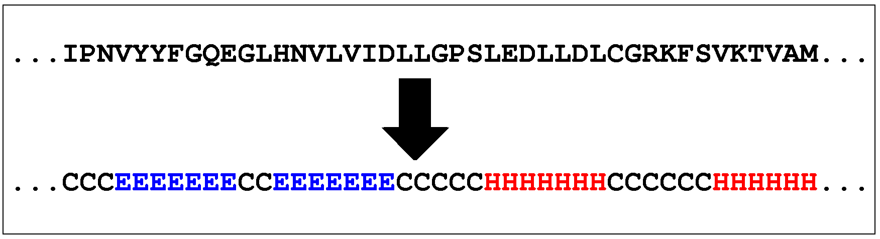
Secondary structure (SS) prediction
Label each amino acid as helix/strand/coil
Predict this label from the amino acid sequence
Connectionist Computing COMP 30230

Slide 30
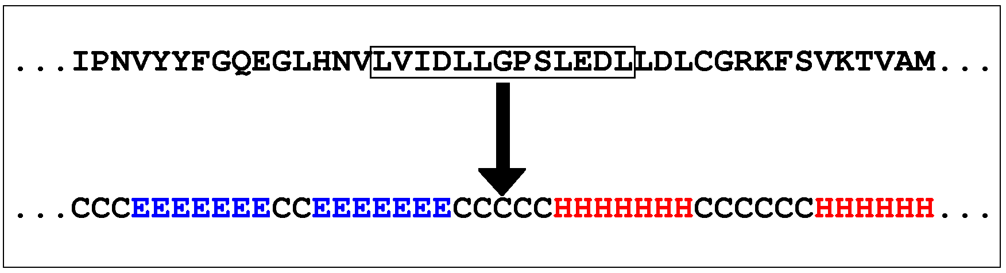
by NETtalk
Qian and Sejnowski 1988.
They used NETtalk to predict it
Sliding window, stacked networks.
Connectionist Computing COMP 30230

